Slide 1
Leadership in Medical Device Engineering
Training Material

Slide 2
Leadership Styles
*Remember that every human has a need for belonging and growth
Authoritarian: (commanding/directing) Suited for low level of qualification or performance
Cooperative: Requires training and contact to team leader
Task oriented
Laisser faire: (delegation) Requires ability and motivation to perform independently
Climatic*:
Needs of and relationships to employees have priority
Relationship oriented

Slide 3
Leadership Styles
Situational leadership: apply based on situation and skills/ needs of the team members
How to learn different leadership styles?
Learn by example: see and understand how your peers do it
Validation: try to consciously apply these styles in micro situations

Slide 4
Teams
Know when to work as a team: if you want to travel fast, travel alone. If you want to embark on a long journey, travel together.
Team size: max. 7 to 8
Beyond that, well-defined roles and structures are needed
To build a team, every team needs to go through 4 phases:
Forming
Storming (conflict phase, battle/ positioning)
Norming (create familiarity)
Performing (constructive collaboration)

Slide 5
Teams
Visualization method to create a team:
Who belongs to the core team?
Which areas, departments, projects contribute to the results?
Names of the internal/external customers
Mission statement:
What is our mission and the primary purpose of the team?
Why do we exist as a team?
What is our greatest challenge?
Upon completion of our work as a team, what is the desired result?
What exactly are the deliverables to our customers?

Slide 6
Teams
Team charta
Identity: team name, members
Mission statement
Objectives (externally specified objectives and own ambitions)
Common rules:
Rules to manage the work
Procedures of team meetings
General rules of collaboration/communication/cooperation, feedback rules
Responsibilities (RACI), who contributes with which competencies? How is information shared and by whom?
How are decisions made?
What are the interfaces that constitute the team boundary?
How to measure results?
Execution plan
What are the milestones and the required means for execution?

Slide 7
Teams
Dimensions to evaluate for team profiling and development
Motivation
Communication
Standards of collaboration/ work ethics
Trust
Ability to take criticism
Cooperation
Clarity of objectives
Customer orientation
Team leadership
Competencies
Level of future readiness
Implementation: assign values from 1-5, visualize in spider chart

Slide 8
The 4 Pillars of Credibility
Function:
Know-how: Competency in subject matter and methods
Results: Deliver on promises, track record, successes
Person:
Integrity: Honesty, congruence between words, action and appearance, values
Intentions: Honest intentions, willingness to provide advantages to stakeholders, loyalty to the organization
Originally established by M.R. Covey

Slide 9
Scope of Leadership Tasks
Trustful relationships
Motivation
Communicative competency
Merge different interests
Commitment = Trust x Convincement (of objective/ task)
Employee/ team
Core tasks:
Focus on objectives
Exercise influence
Create collaboration
Core levers:
Self-leadership
Communication
Strategy
Leader
Tasks/ objectives
Self leadership
Self reflection/ identity, mindset
Clarify own role, create acceptance
Ability to take decisions
Ability to take different perspectives
Focus, create objectives
Adjust agreements, mobilize support
Know the power structures
Create roadmap (tactical steps and strategy)

Slide 10
Leadership DNA
Personal values (e.g. hope, excellence, commitment) Method to identify them: who are the role models that have influenced you throughout your life? What are the values associated with them? Which ones of these values have to you transferred into your life?
Strengths/Weaknesses Method to identify them: strengths seen by you, colleagues, friends/family, when do I inspire others?
Roles Coach, delegator, trainer, decision-maker, role model, mentor, visionary, problem solver, “Macher”, cheerleader, listener, communicator, manager, innovator, networker, supervisor, conflict manager, organizer, strategist, motivator, adaptor, influencer, goal setter, executive
Vision/ big picture

Slide 11
Roles and Communication
Some say, communication is
7% content
35% voice
58% body language
However, people notice when you superimpose language/ external appearance over your own personality or role
Instead, use playgrounds to create and practice spaces of language
Always use language from inside out, so it is in line with your personality/role.
Basic attitude for a communication, by Carl Rogers: be real (I-message), be empathic (active listening), show acceptance (avoid blockers, open doors for active listening of others)

Slide 12
Disciplinary vs. Networking Aspects
C-level manager
Team leader with limited disciplinary responsibility
Project manager large-scale projects
Product manager
Level of leadership
Team leader
Project manager
Team coordinator
Subject matter expert
Change manager
Level of networking

Slide 13
Stakeholder Expectations
“The future of the company” / generate business/ visibility
Deliver what you promise and what is specified (time, money and quality)
Other stakeholders
Customer
Project manager/ systems engineer
Often, expectations are antinomies (mutually exclusive)
Expectations
Work independently, per common values/ understanding
Team/ organization
Disciplinary superior
Get clear instructions
(“Tell us where to go”)
Develop well as a resource for the organization
“Let me do my job”
“You have no authority/competency”
Independent/pro-active development (grow by looking left and right)
Let me know early to raise needs for resources

Slide 14
Expectation Management
Communicate expectations early-on, so you can relate to them in case of conflict.
As an alternative strategy to explicit communication: validate expectations early-on with micro milestones (keep it simple, e.g., run a sprint with small yet challenging tasks)

Slide 15
Stakeholder Management
Demonstrate! that the project is “the future of the company” / generate business/ visibilty
Other stakeholders
Build and maintain trust
Customer
Deliver!
Project manager/ systems engineer
Stakeholders are the key to get priority in case of project needs
Influence / manage
Work independently
Team/ organization
Disciplinary superior
Give clear instructions
Grow!
Delegate tasks and responsibilities
Ask for expertise/ subject matter education
Ask for needs

Slide 16
Tricks and Tools
Talk openly to stakeholders: What are your expectations? Only this allows you to obtain actionable intelligence.

Slide 17
Conflict Management
Steps in a conflict:
Participants solve the conflict by themselves. Suggest a conflict discussion.
Conflict discussion
“Clarification bridge”:
self explanation
diagnosis
dialogue
Exit: If the conflict cannot be solved, the project must be protected from the conflict. The conflict participants must leave the project.
Note: An organization without healthy conflicts does likely not have objectives.

Slide 18
Tricks and Tools
How to avoid badmouthing: resolve conflicts directly (not indirectly). Use proven (razer sharp) arguments, no presumptions or vague insinuations. Note that this is a great effort, but it pays off.
Conflict resolution in case of expectation violations: make sure to have set an expectation benchmark.
Seek conflicts: Have the courage to state the own needs and problems (example: when management/ internal customers change directions all the time, middle management needs to raise the conflict).
Question behaviors and learn from experienced peers: Habits are often based on rationale conclusions from experiences made in the past. With experienced peers, use their wisdom to reach the common objective most efficiently, identify the essential interfaces for collaboration.

Slide 19
Meetings
Purpose, Process, Payoff
Communicate in the invitation
Types
informative
management (planning/reporting)
problem solving (creative/ brainstorming)
productive (work session)
Maker's Schedule, Manager's Schedule
Make sure not to interrupt the schedules of the makers
Delegate roles
Preparations
Minutes
Action items
Visualization
Feedback provider (ask participant to provide feedback in the wrap-up)
Document results (SMART)
After each item, formulate and record results in the MOM
Share minutes right after the meeting

Slide 20
Meetings
Feed forward method (for regular daily/weekly meetings)
3 sentences, 2 min per participant
Each participant reports on current work, successes, problems, help needed.

Slide 21
Spiral of Success
Spiral of success: people in your environment and places help you stay on course and give you energy
Exercise: Draw a balance sheet
Put yourself in the middle
Draw down the core people around you
Mark the energy givers and absorbers with +,++,+++ or -, --, ---
Derive conclusions (e.g. whom to thank/avoid, conflict resolution?)
Networking interaction is a means to lead yourself/a team to goals beyond an individual’s perception:
One cannot be better than one’s self-perceived permits
Self-perception is also a result of interaction with others
New perspectives needed to break one’s own logic

Slide 22
Problem Solving through Alternatives
Define Point A (situation) Problem statement, e.g. “no business”
Define Point B (alternative) Specify the alternative, e.g. what it means to have business
Draw steps from Point A to Point B

Slide 23
Delegating
Basic questions to ask:
Which tasks belong to the most important 20% of my tasks?
Who can do these tasks better/ faster than me?
Which employees have the potential capacity to do them?

Slide 24
Delegating
Task definition for delegation:
What (objective, level of difficulty)
Who (competency, prerequisites)
What for (purpose, objective, who takes responsibility?)
How (process, execution, feedback)
With what (tools, resources)
When (start, end, priority)
Guideline to delegate a task:
Preparation (explain the objective, reason, qualifications of the employee)
Orientation (reason to delegate, meeting objective)
Clarification (explain task type, agree on task (what/who/..), measures, actions, control of success, documentation)
Anchoring (who by when and what)
Conclusion (summarize meeting results)

Slide 25
Caffeine
Read about the effects of sleep/ food intake/ caffeine/ exercise. Understand your biological rhythm.
Schedule your intake and activities accordingly.

Slide 26
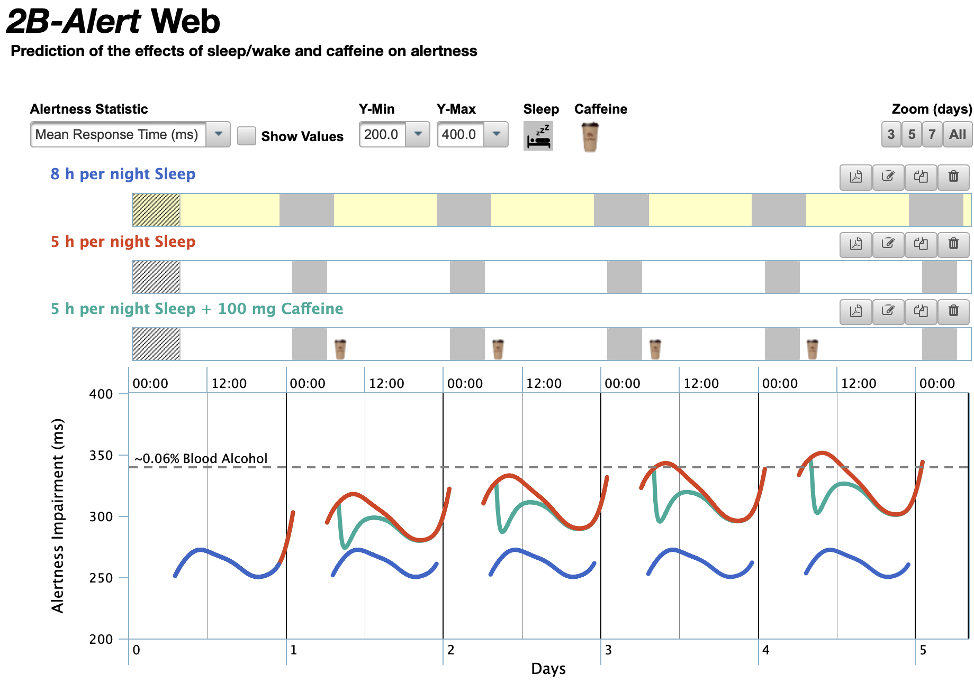
Caffeine
https://2b-alert-web.bhsai.org

Slide 27
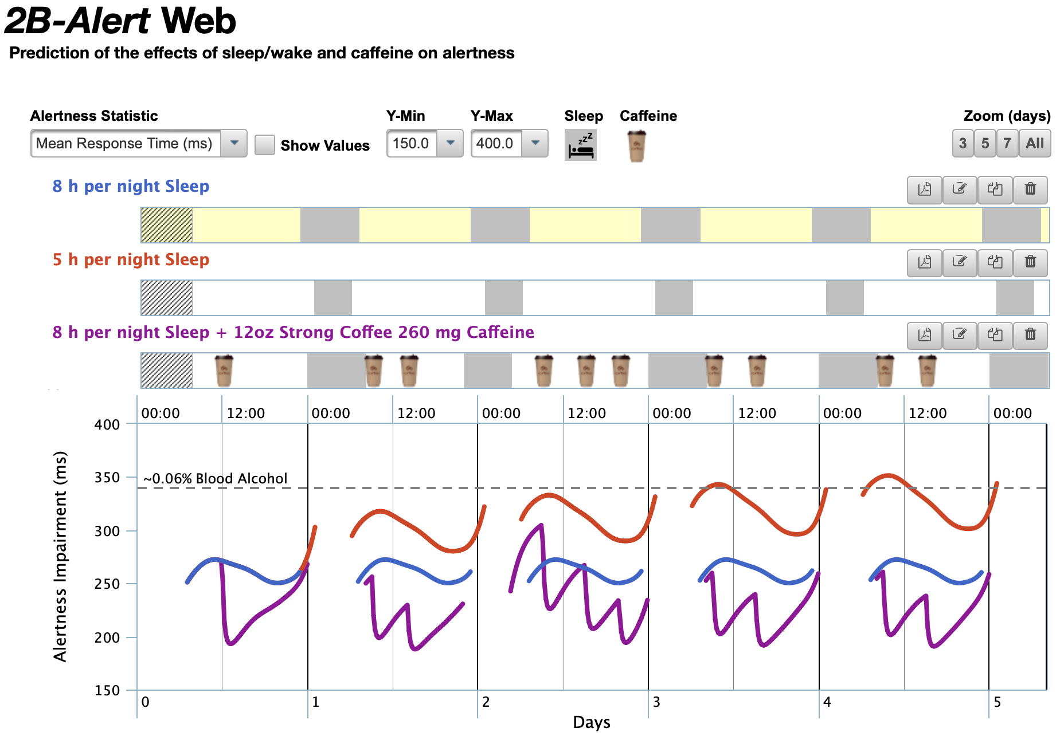
Caffeine
https://2b-alert-web.bhsai.org

Slide 28
Culture
Baseline culture:
Criticize negatives, ignore positives
Alternative culture:
Highlight, work and penetrate on pain points (of oneself and others)
Give positive feedback, highlight and celebrate positives
Effectively move discourse to the relevant points

